Slide 1
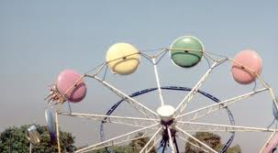
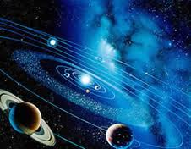
Uniform Circular Motion
Circular Coordinates
r-radial
r
θ-tangential
θ

Slide 2
Uniform Circular motion occurs when an object moves in a circular path at a constant speed.
|v|=v
● the instantaneous velocity v is
TANGENT to the path and has constant magnitude
a
● Since the speed is constant, there
is NO ACCELERATION tangentially
r
● Acceleration is directed radially inward and acts to change velocity direction
v
● CENTRIPETAL ACCELERATION means centre-seeking

Slide 3
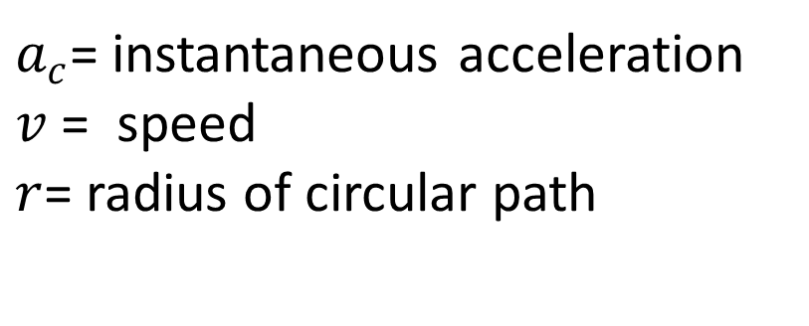
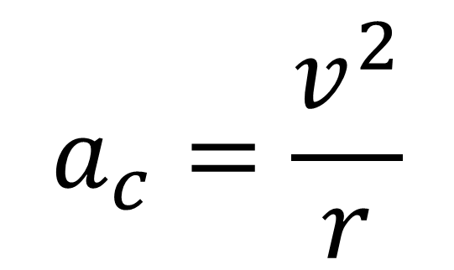
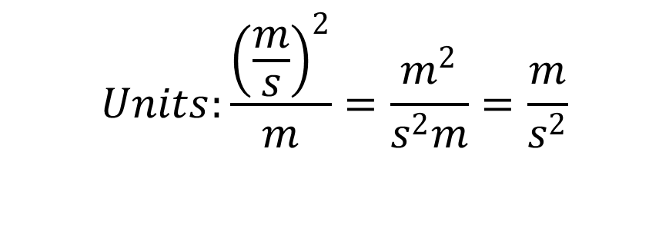
Instantaneous Acceleration Magnitude
$$a_{c}=\frac{v^{2}}{r}$$
$a_{c}$= instantaneous acceleration
$v$= speed
$r$= radius of circular path
$$Units:\frac{{\left(\frac{m}{s}\right)}^{2}}{m}=\frac{m^{2}}{s^{2}m}=\frac{m}{s^{2}}$$

Slide 4
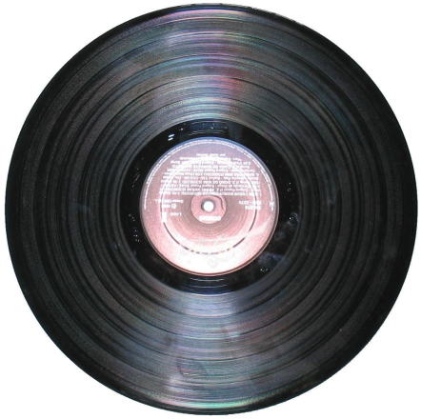
Applications:
Orbital motion
-planets about sun
-moon, satellites about Earth
Rotating Objects
-wheels, vinyl records
-amusement park rides (Windseeker!)
-spinning a bucket over your head
-washing machine, centrifuge

Slide 5
Example 1: A child on a merry go round is
3.0 m from the centre of the ride. If the child’s speed is 2.0 m/s, what is the magnitude of the child’s centripetal acceleration?
Ans:
V= 2.0 m/s
r=3.0 m
a_{c}=?
a_{c}=v²/r = (2.0)²/3.0= 1.3 m/s²

Slide 6
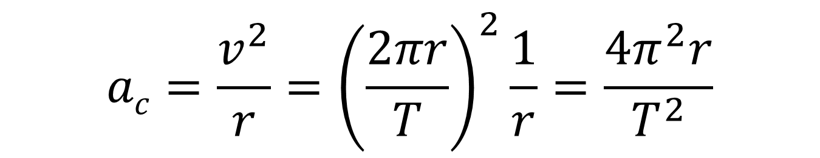

Other forms of the equation:
Given radius and period (T):
Circumference, C=2πr (Units: m)
r
Period, T= time for one revolution (Units: seconds)
C
$$v=\frac{2πr}{T}$$
Speed :
We can rewrite the acceleration:
$$ac=\frac{v^{2}}{r}={\left(\frac{2πr}{T}\right)}^{2}\frac{1}{r}=\frac{4π^{2}r}{T^{2}}$$

Slide 7
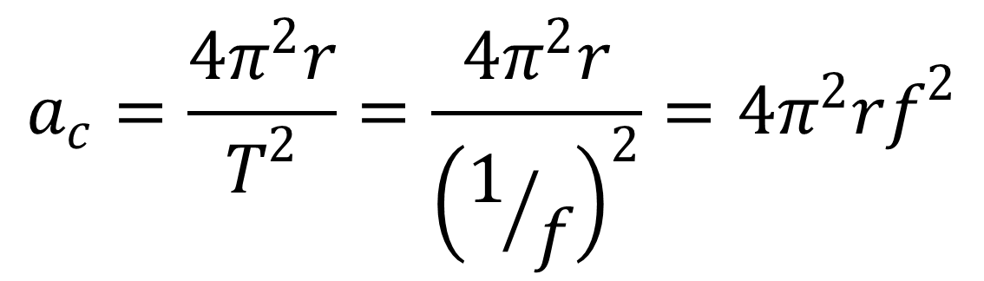
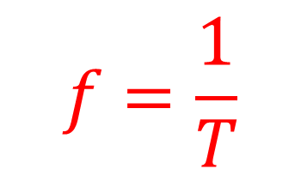
Given radius and frequency (f):
Frequency (f)- is the number of cycles that occur in one second. Frequency is the inverse of period.
$$f=\frac{1}{T}$$
Units: s⁻¹ or Hz
Substituting this expression in for period:
$$a_{c}=\frac{4π^{2}r}{T^{2}}=\frac{4π^{2}r}{{\left(1/f\right)}^{2}}=4π^{2}rf^{2}$$

Slide 8
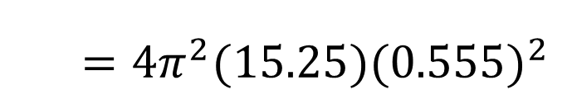
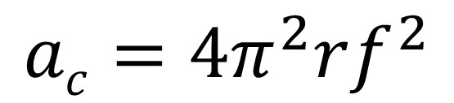
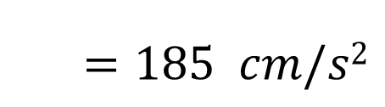
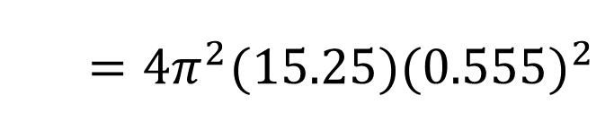
Example 2: A classic LP vinyl record has a diameter of 12.0 inches (30.5 cm) and rotates at 33.3 rpm (revolutions per minute). What is the centripetal acceleration of an ant sitting at the outermost edge of this record?
Solution:
r=30.5 cm/2=15.25 cm
f=33.3/60.0s =0.555 Hz
a_{c}=?
$$ac=4π^{2}rf^{2}$$
$=4π^{2}(15.25){(0.555)}^{2}$
$=4π^{2}(15.25){(0.555)}^{2}$
$=185 cm/s2$

Slide 9

Thinking questions:
Question 1: The Earth travels around the Sun at a constant orbital speed. At any given point in its travel, the Earth’s acceleration is constant in magnitude and directed:
tangentially forward along the path
tangentially backward along the path
radially outwards away from the Sun
radially inwards towards the Sun

Slide 10

Question 2: On a merry go round, child A is 1.0 m from the centre while child B is 4.0 m from the centre, near the outer edge. How do the magnitudes of their tangential speeds compare?
A is travelling faster.
B is travelling faster.
They are travelling at the same speed
Impossible to know without knowing the rate of rotation.

Slide 11
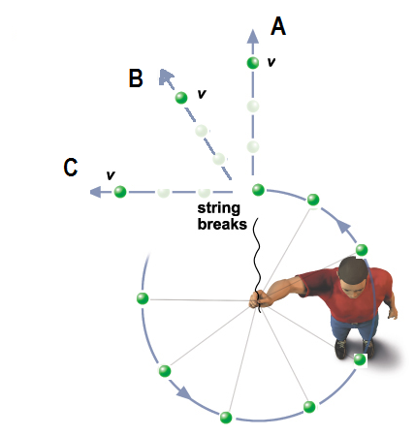
Question 3: A boy swings a ball on the end of a string at a constant speed in a horizontal circle. The string breaks at the point shown in the diagram below. In what direction will the ball move?
A
B
C
The ball will continue in the circular path.

